Slide 1
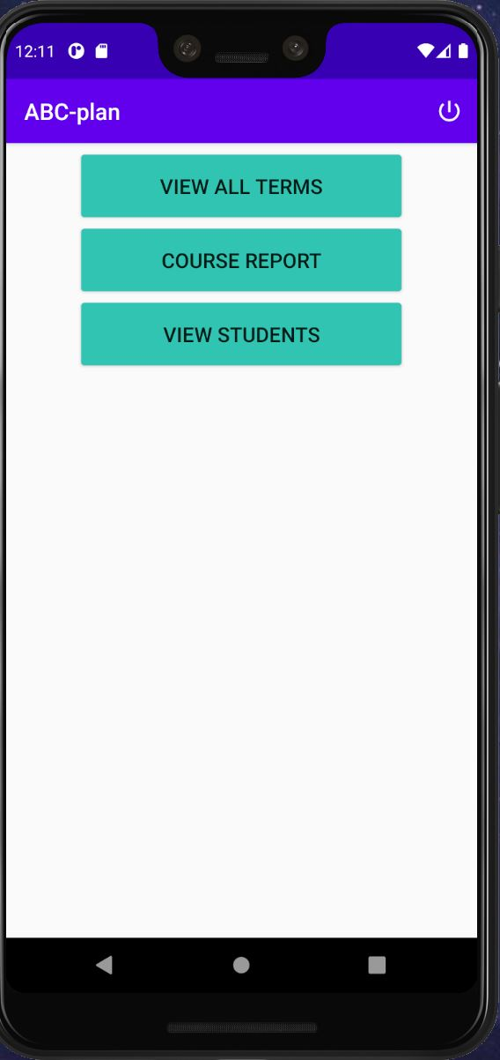
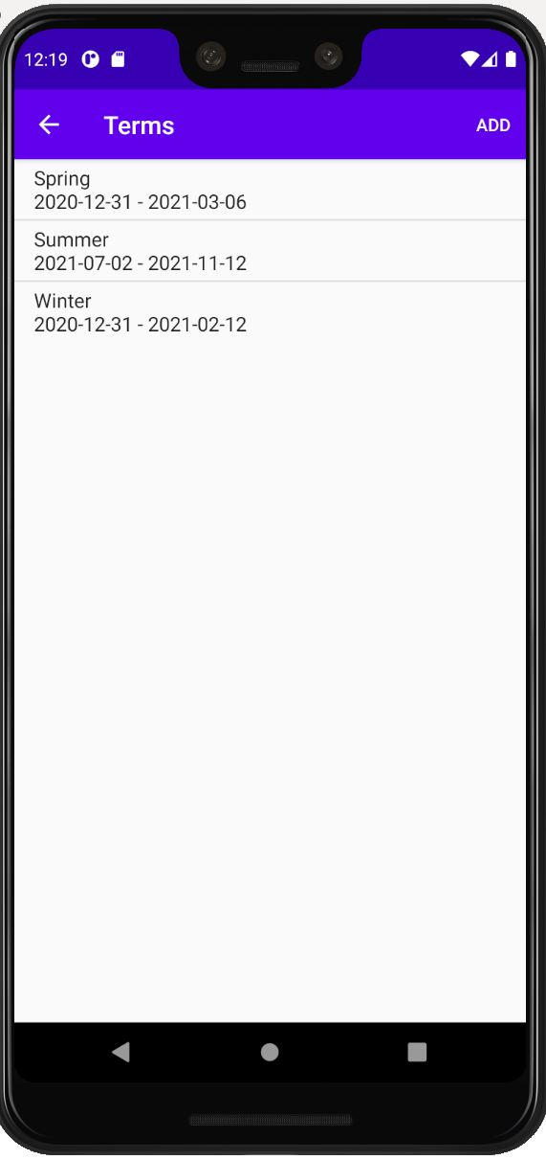
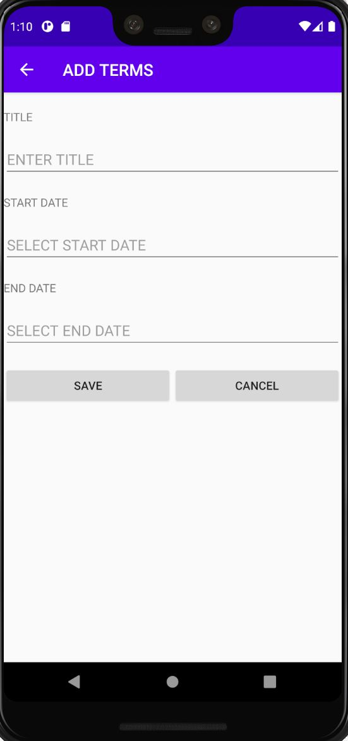
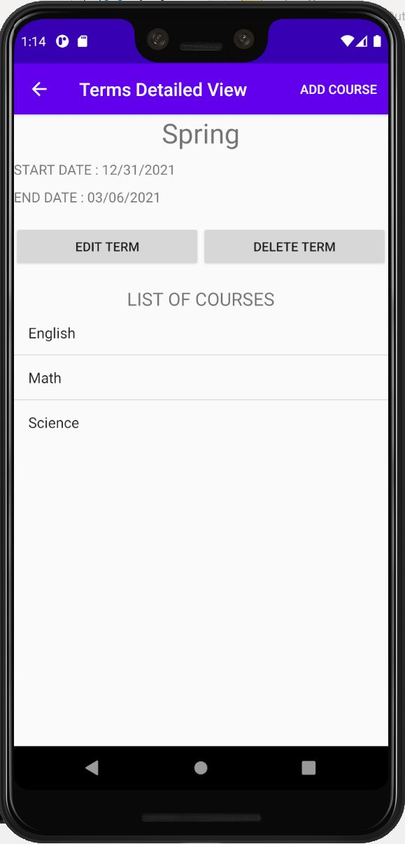
Terms
ABC-Plan
A Teacher’s Planner
(Manual)
1
To view the list of existing Terms: Select the button “View All Terms”
2
The following is the List of existing Terms. To add a new term, click on the add button.
3
Complete the fields with the required information and click on save to create the new term.
4
Once you click on one of the terms, you will be able to see the Detailed View Screen.

Slide 2
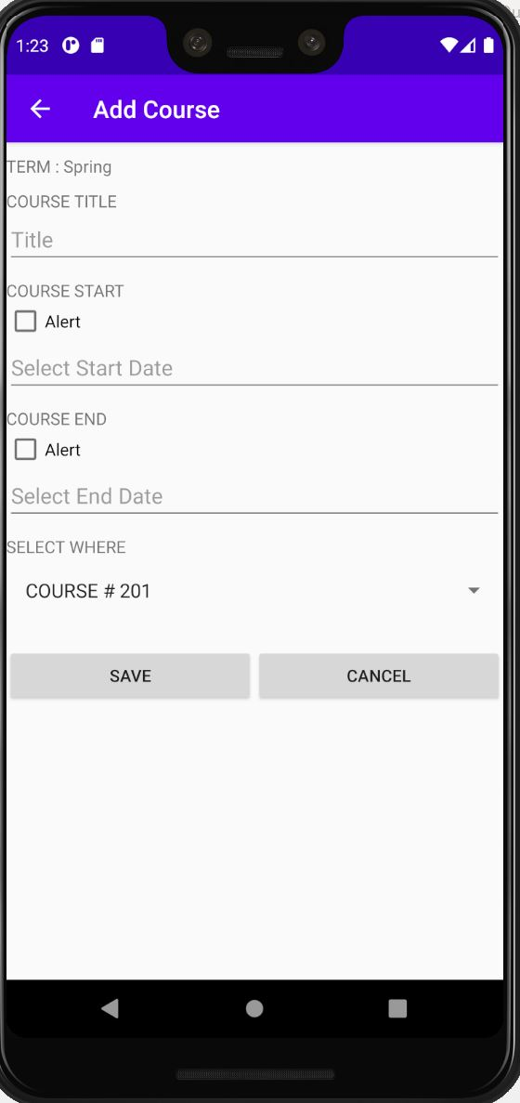
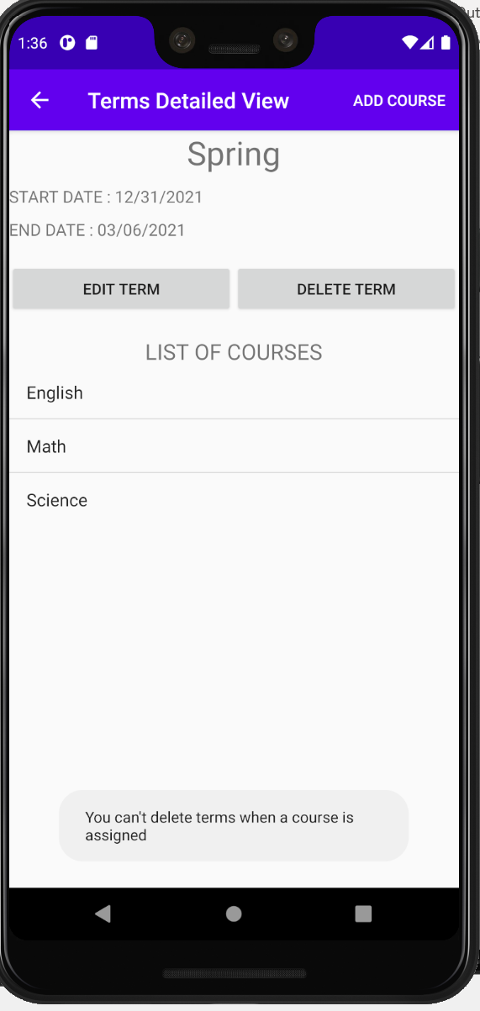
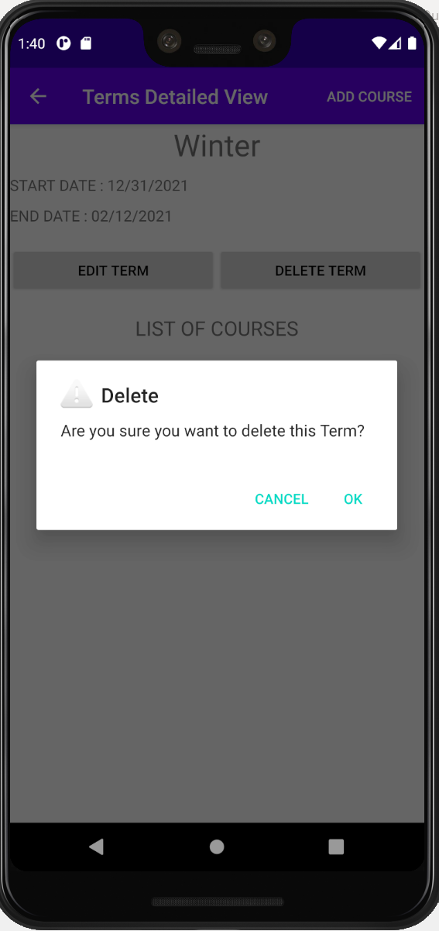
Terms
ABC-Plan
A Teacher’s Planner
(Manual)
5
To Add a course all the fields in this screen must be filled following by the save button.
6
Once you click the button Delete Terms It will delete the selected term, unless there are courses enrolled. The Term must not have courses enrolled to qualify for deletion.
7
When a Term doesn’t have any courses enrolled and you click the delete button, a confirmation message will pop-up.

Slide 3
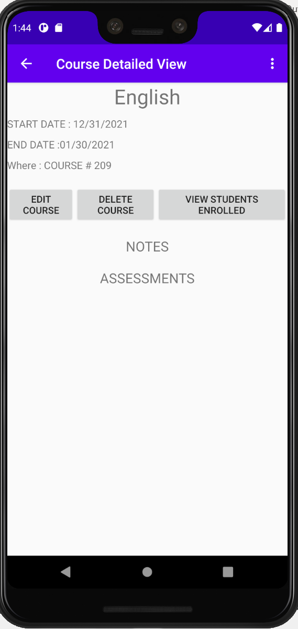
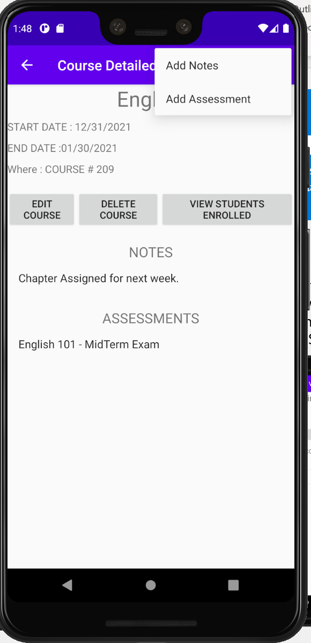
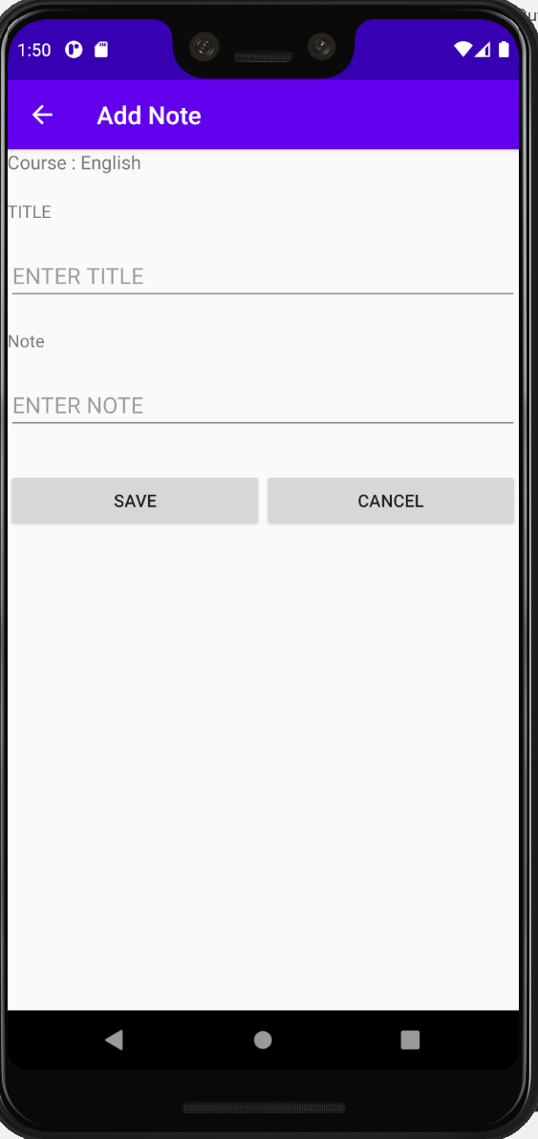
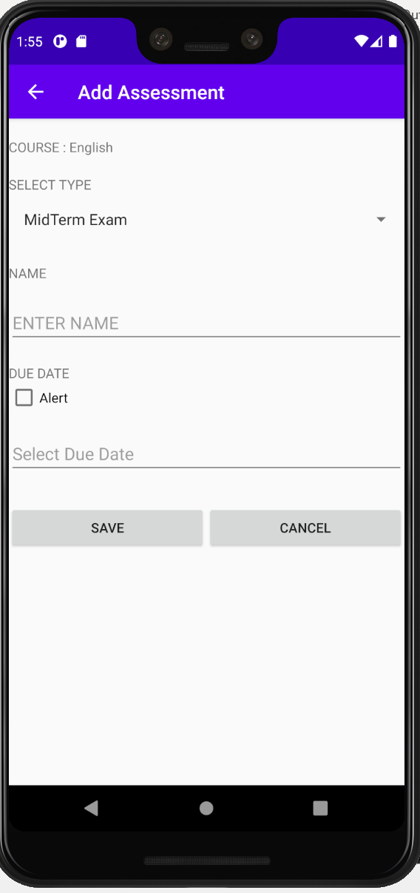
Courses
ABC-Plan
A Teacher’s Planner
(Manual)
1
Once a course is clicked, a detailed view of the course will be shown.
2
If the menu bar is clicked, there will be an option to add notes or assessments.
3
Once clicked the Add Notes button, this screen will allow to add a note.
4
Once clicked the Add Assessment button, this screen will allow to add an assessment.

Slide 4
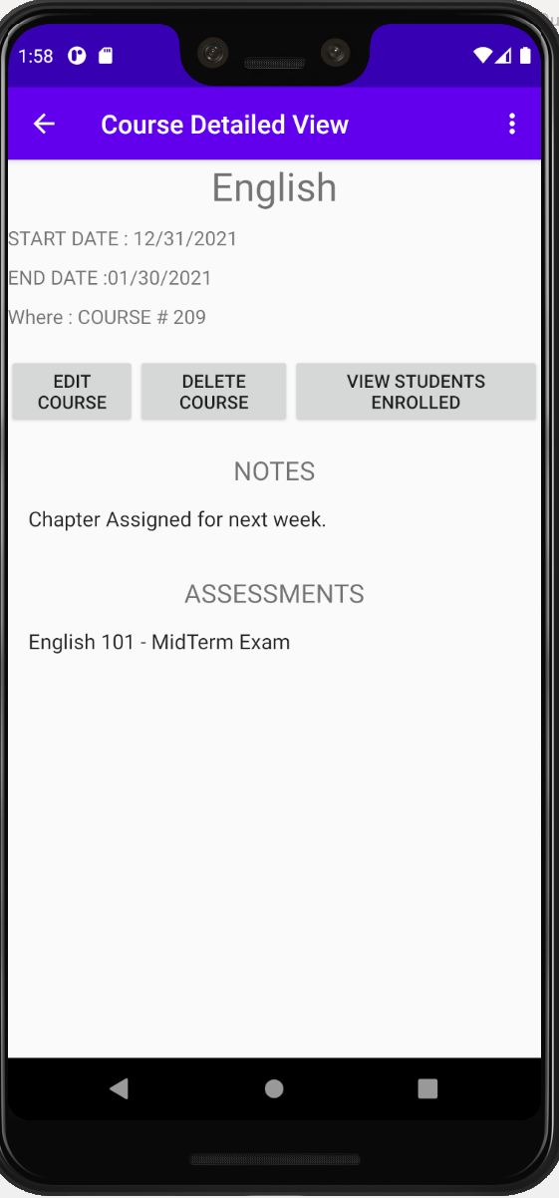
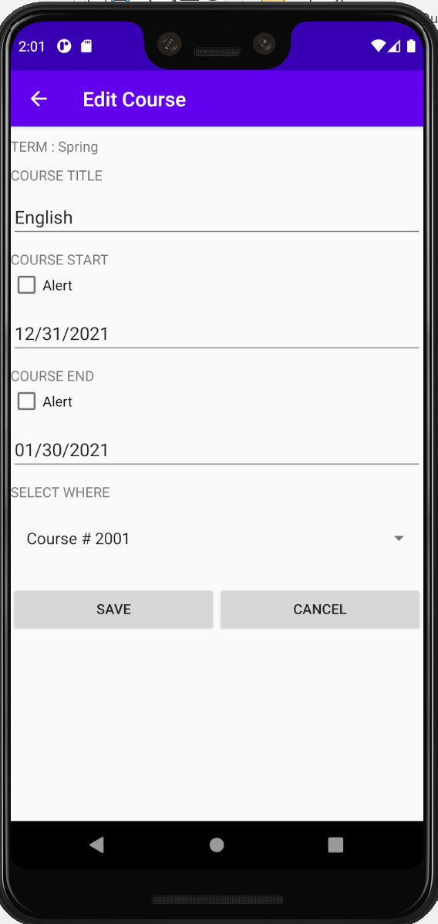
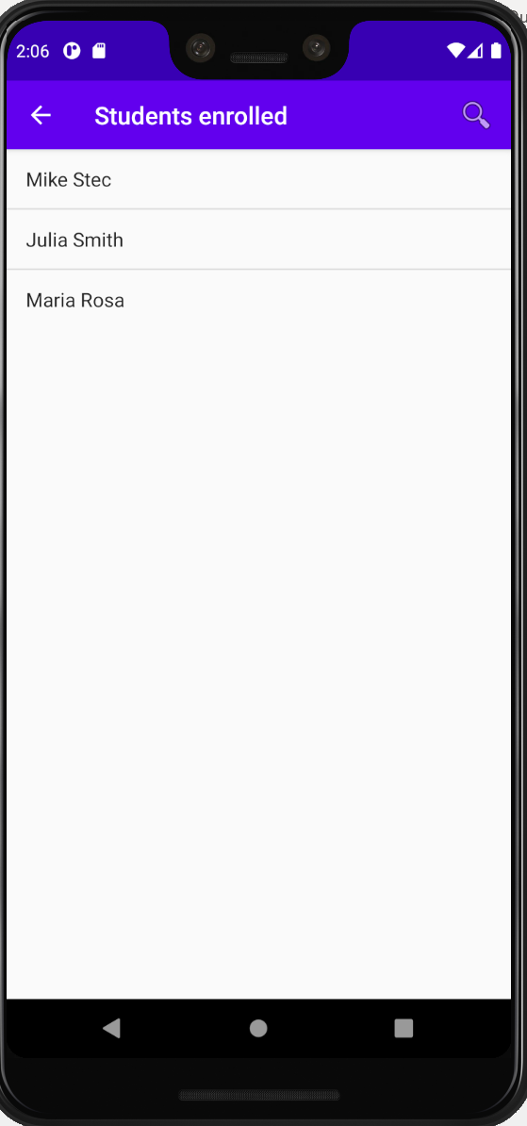
Courses
ABC-Plan
A Teacher’s Planner
(Manual)
5
Notes and Assessments will be displayed and clicked, a detailed view of each will be displayed.
6
Edit Button Clicked
7
View Students Enrolled Screen.
8
Once the View Students Enrolled is clicked, it will show the students enrolled for that specific course.

Slide 5
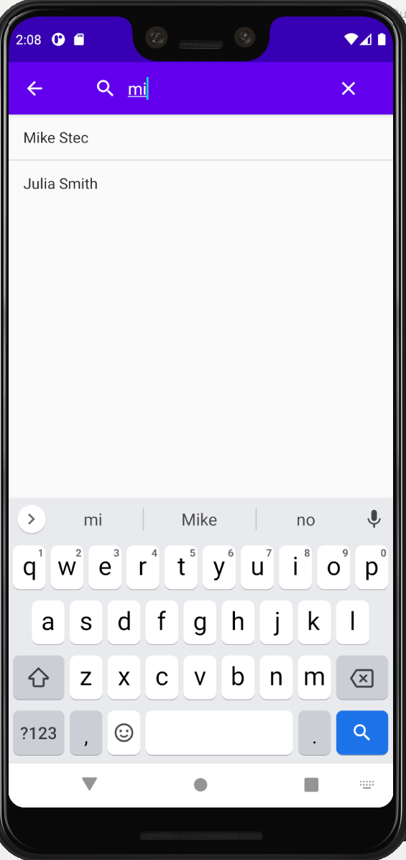
Courses
ABC-Plan
A Teacher’s Planner
(Manual)
9
A filtered search can be done by typing the beginning of the name wanted. Just click on the loop icon on the right top corner.

Slide 6
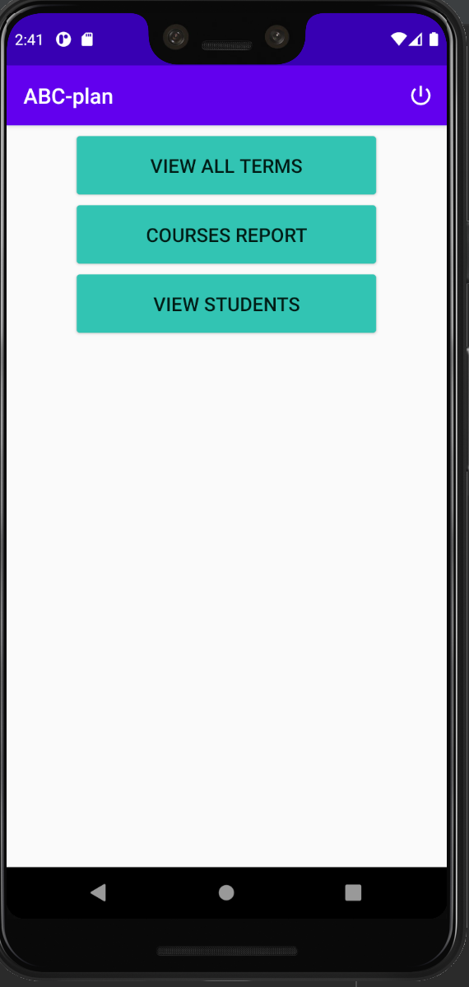
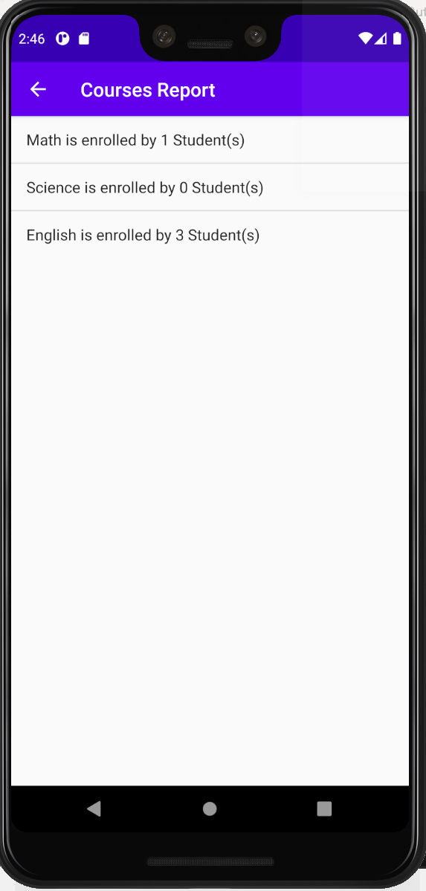
Courses Report
ABC-Plan
A Teacher’s Planner
(Manual)
1
Click on Courses Report to access to the Courses Report Details.
2
Courses Report screen.
Courses quantities and appearance will change dynamically.

Slide 7
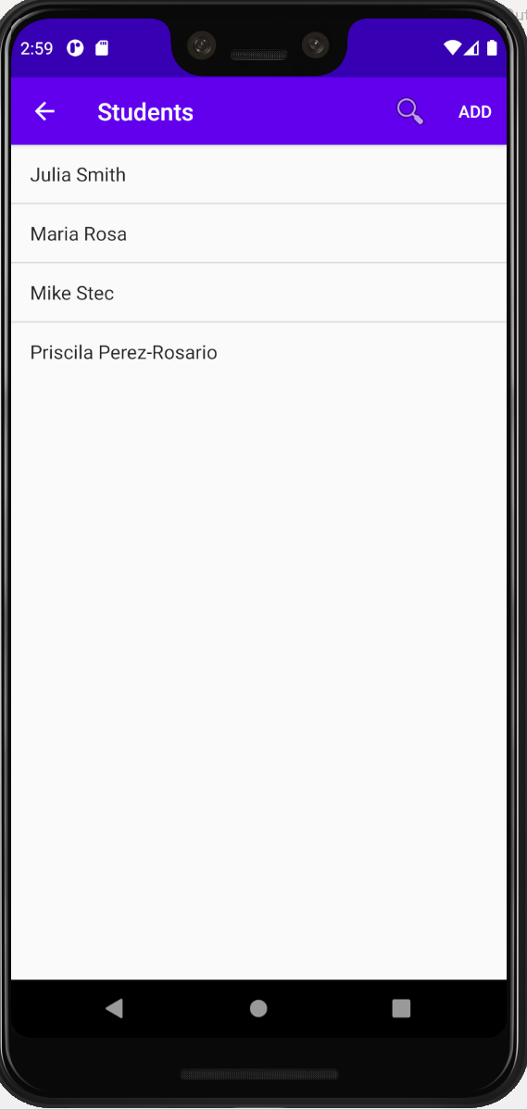
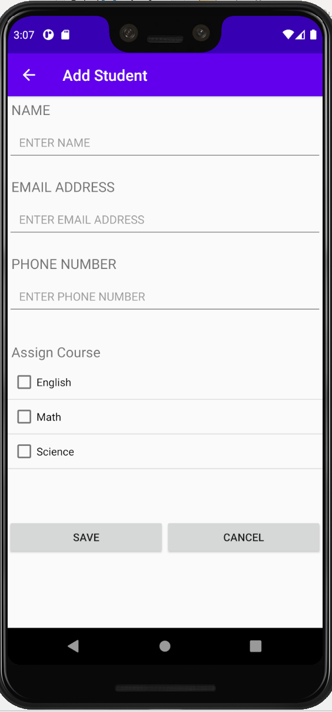
Students
ABC-Plan
A Teacher’s Planner
(Manual)
1
Students Button Screen.
2
Add Student by clicking. Add Student and complete the information required, followed by the save button.

